Slide 1
Azure Virtual WAN Design Study for Multi-Site Connectivity
Title:

Slide 2
Seelam Thanush Reddy – 2400090160
Tummala Himesh – 2400090192
Devagiri Vangmai – 2400090199
Ambati Lahari Naga Sai - 2400090177
Roles In Project:
Project team:
Azure Student/Free Services & Credits
Virtual WAN Feasibility
Hub-and-Spoke Alternative
Cost, Limits & Final Feasibility

Slide 3
Problem Statement
Organizations with multiple campuses and Azure workloads need reliable connectivity between their locations and cloud resources. Traditional networking can require complex VPN connections and routing configurations.
This project investigates whether Azure Virtual WAN can provide a centralized and scalable solution for connecting multiple campuses and Azure VNets.
The study also considers two practical challenges:
Virtual WAN can be expensive for a small number of sites.
Advanced routing, particularly Routing Intent, can be complex to configure and manage.

Slide 4
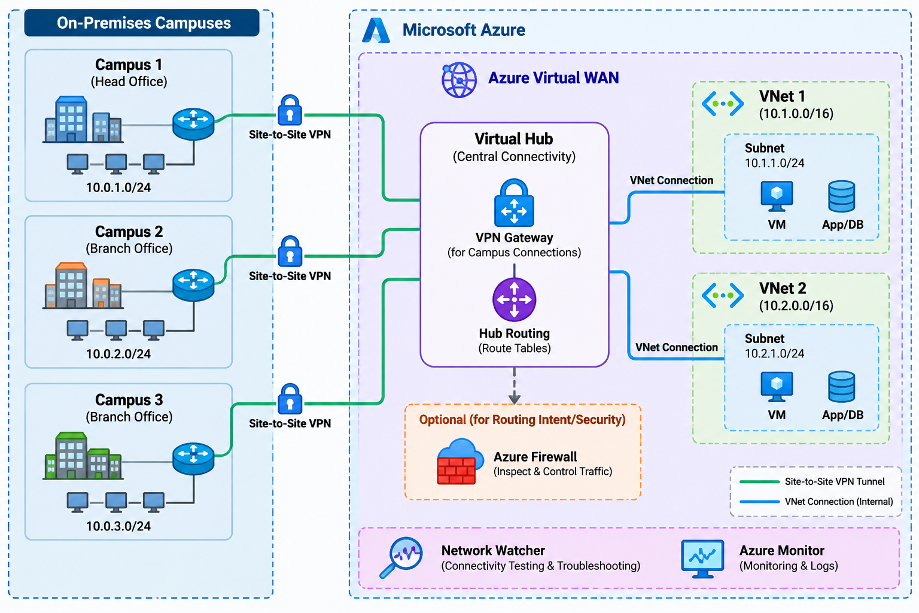
Architecture

Slide 5
Main Azure Services
Service | Role
Azure Virtual WAN | Overall multi-site networking
Virtual Hub | Central connectivity and routing
VPN Gateway | Connects campus sites
VPN Sites | Represents the 3 campuses
Azure VNet | Represents the 2 cloud networks
VNet Connections | Connect VNets to Virtual Hub
Hub Routing | Controls traffic between sites and VNets
Network Watcher | Connectivity testing/troubleshooting
Azure Firewall | Optional security and Routing Intent demonstration

Slide 6
Major Use Cases
Use Case 1 — Campus-to-Azure connectivity
Campus 1 ─┐
Campus 2 ─┼── Virtual WAN Hub ── VNet 1
Campus 3 ─┘ └── VNet 2
Use Case 3 — VNet-to-campus communication
Azure workloads in VNet 1 or VNet 2 can communicate with campus networks.
Use Case 4 — Architecture comparison
Virtual WAN
VS
Traditional Hub-and-Spoke
Use Case 2 — Campus-to-campus communication
Traffic from Campus 1 can be routed through the Virtual WAN infrastructure to Campus 2 or Campus 3.

Slide 7
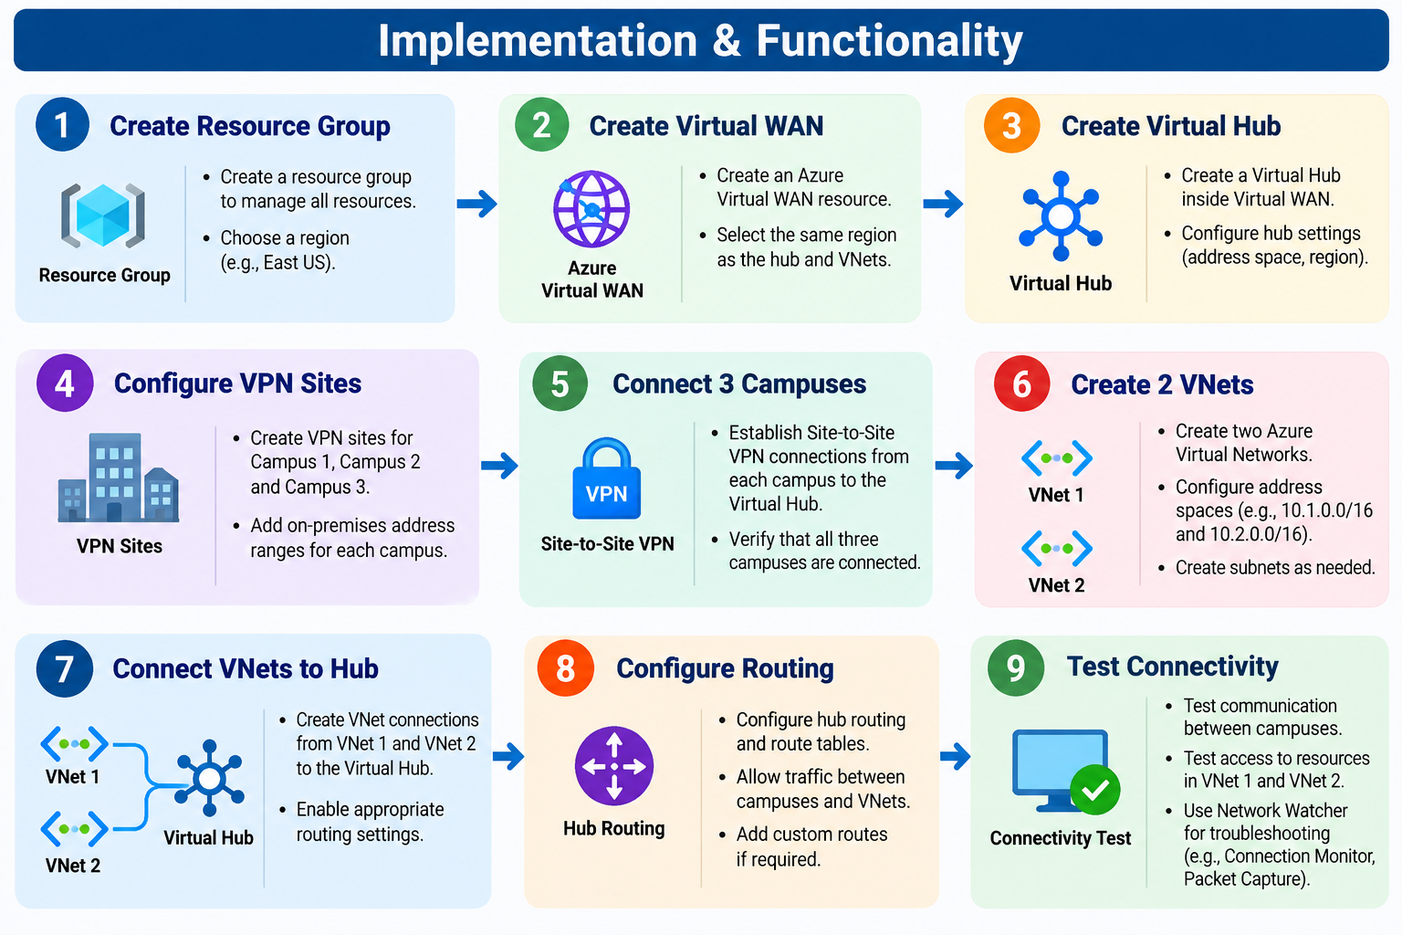
Implementation

Slide 8
Expected Outcome
At the end of the project, we expect to:
Successfully connect 3 campuses to Azure using Site-to-Site VPN.
Connect 2 Azure VNets to the Virtual WAN Hub.
Enable communication between campuses and Azure VNets.
Configure centralized routing through the Virtual Hub
Test network connectivity and verify that traffic reaches the correct destination.
Understand the cost and routing challenges of Azure Virtual WAN.
Compare Virtual WAN with the traditional hub-and-spoke architecture.
Identify which architecture is more suitable for small multi-site environments based on cost, scalability, and management requirements.

Slide 9
Thank You

